Slide 1
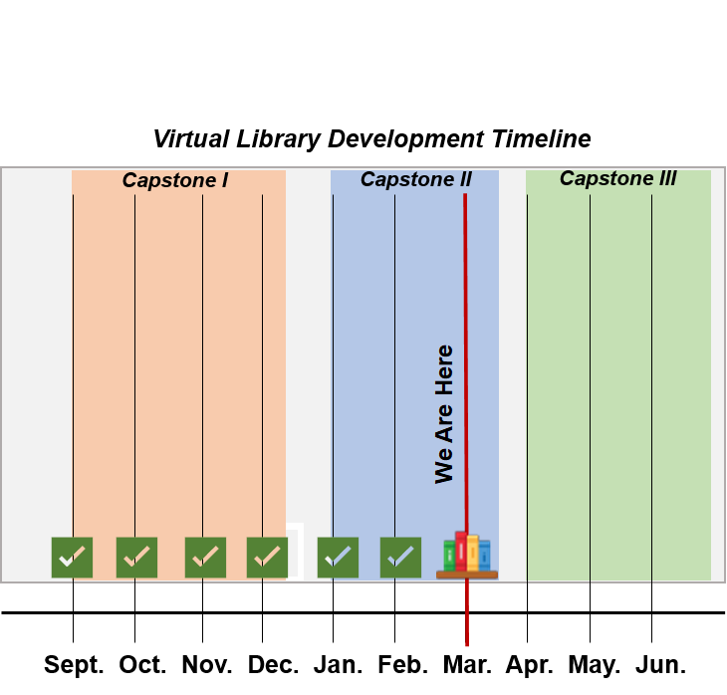
Capstone I Final Presentation
Feature Additions
Refinement of Features
Documentation
Design
Prototyping

